Slide 1
Southern Maine ADI Grant Overview
MCHQS: September14, 2015

Slide 2
ADI Grant
Alzheimer’s Disease Initiative (ADI) grant from Administration for Community Living (ACL)
Duration: 10/1/14 – 9/30/17- 3 years
Partners: MMC Geriatric Center; Alzheimer’s Association, Maine Chapter; Community Partner’s Inc.; and University of Southern Maine; others identified during project period

Slide 3
ADI Goal
Provide a more comprehensive and sustainable NETWORK of training, referral, and person-centered services to support individuals living with dementia and their family caregivers

Slide 4
ADI Major Elements
People living alone with dementia
Behavioral symptom management & consultation
Intellectual disability aging into dementia

Slide 5
Dementia is a Game Changer
From
Rehabilitation
To
Habilitation

Slide 6
Aging into Dementia
People with Down syndrome
People with ID experiencing age-related health issues
Caregivers of people with ID who are themselves aging
Other family members assuming the role of primary caregivers
Paid staff

Slide 7
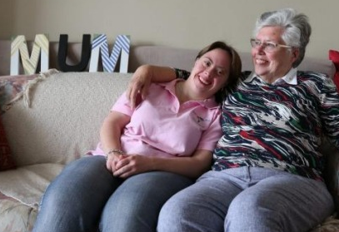
ADI Services for People with ID Aging into Dementia
Two Adult Day Service Centers
Outreach to identify those not in system
NTG Training for family and paid caregivers *
Family Caregiver program
Networking and information sharing
Increase I&R knowledge and referral capacity
Notes:
In Maine, 3,500 people with ID/DD live at home with a caregiver over the age of 60.
75% of those with Down Syndrome have Alzheimer’s
By age 40 25% show symptoms

Slide 8
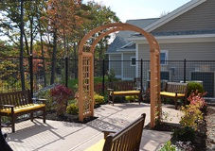
Expanded Services for Family Caregivers
Allen Cognitive assessment of Adult Day members
ID and dementia training for ADS and other paid staff
NTG Training for family caregivers of people with ID
Embedded Caregiver Specialist at MMC Geriatric Center

Slide 9
Network outcomes
Integration of SMAA programs
Upgraded staff and volunteer skills
Increased community awareness
Aging and ID provider information sharing and collaboration
Collaboration/contracts with public and private payers

Slide 10
ADI Project Contacts
Katlyn Blackstone, Project Director, 396-6552 kblackstone@smaaa.org
Liz Weaver, Project Manager, 396-6578, lweaver@smaaa.org
Ann O’Sullivan, Family Caregiver Coordinator, 396-6541, aosullivan@smaaa.org
Mark Anderson, Community Health Worker Specialist, 396-6534, markanderson@smaaa.org
Linda Samia, Project Evaluator, University of Southern Maine, lsamia@usm.maine.edu

